Slide 1
ByteBuddies
X-Coders: Ilya Mruz, Tikki Cui, Nathan Roberts, Sachit Tripathi

Slide 2
Problem
Going to university is often overwhelming
Being assigned a mentor
We will create a service that will match mentors and mentees
Future possibilities are limitless

Slide 3
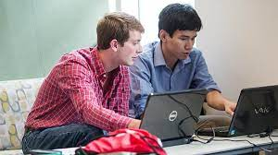
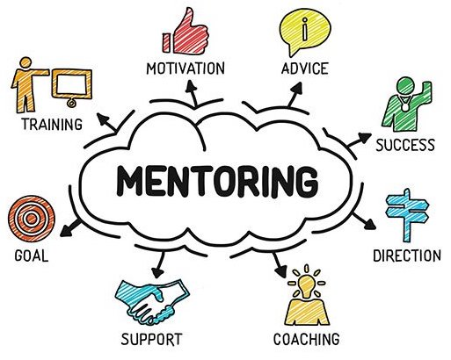
Solution
Connect CS students with mentors
Tailored Matching
Structured Guidance
Interactive Learning
Skill Development

Slide 4


Related Work

Slide 5
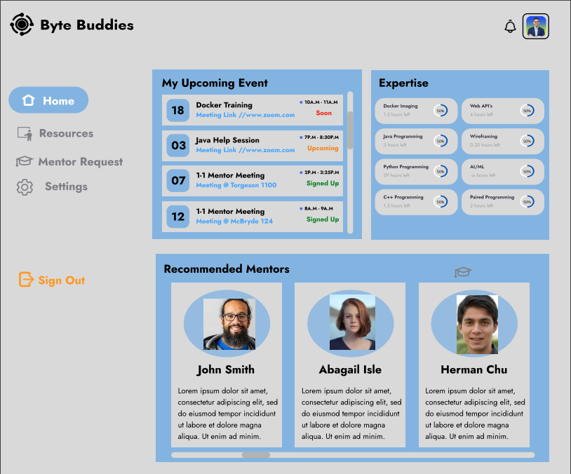
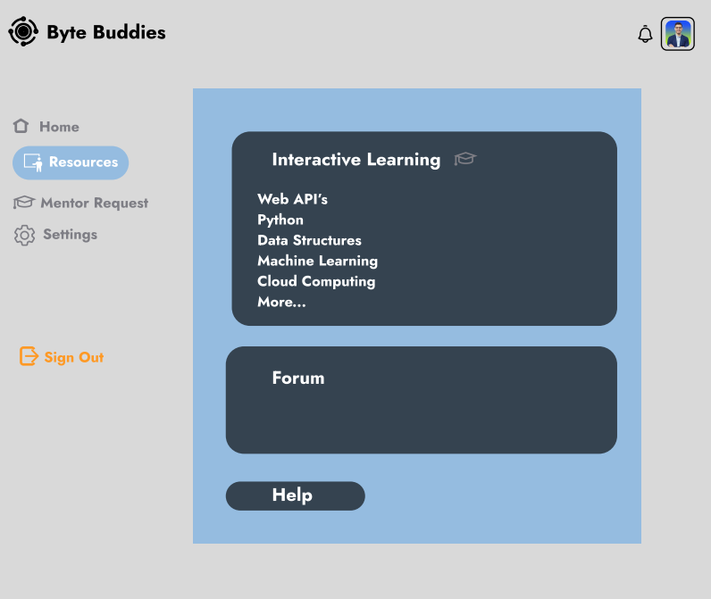
Mock Interface

Slide 6
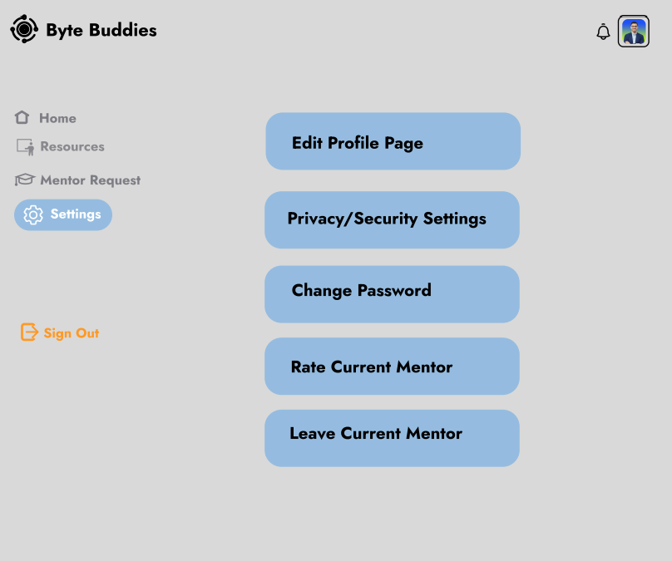
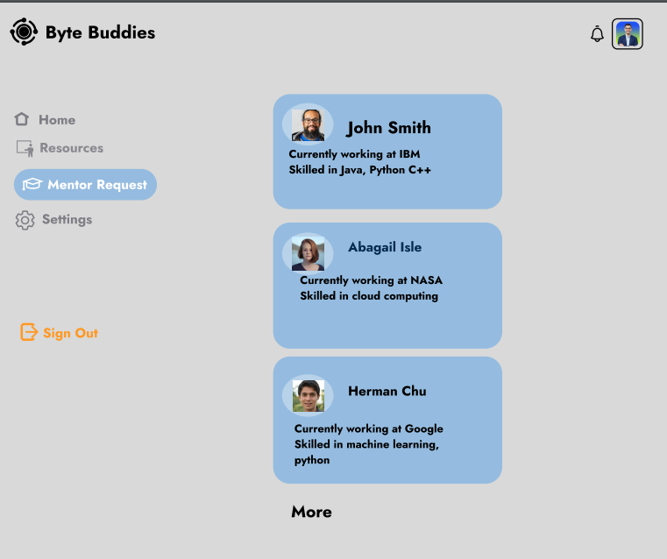
Mock Interface

Slide 7
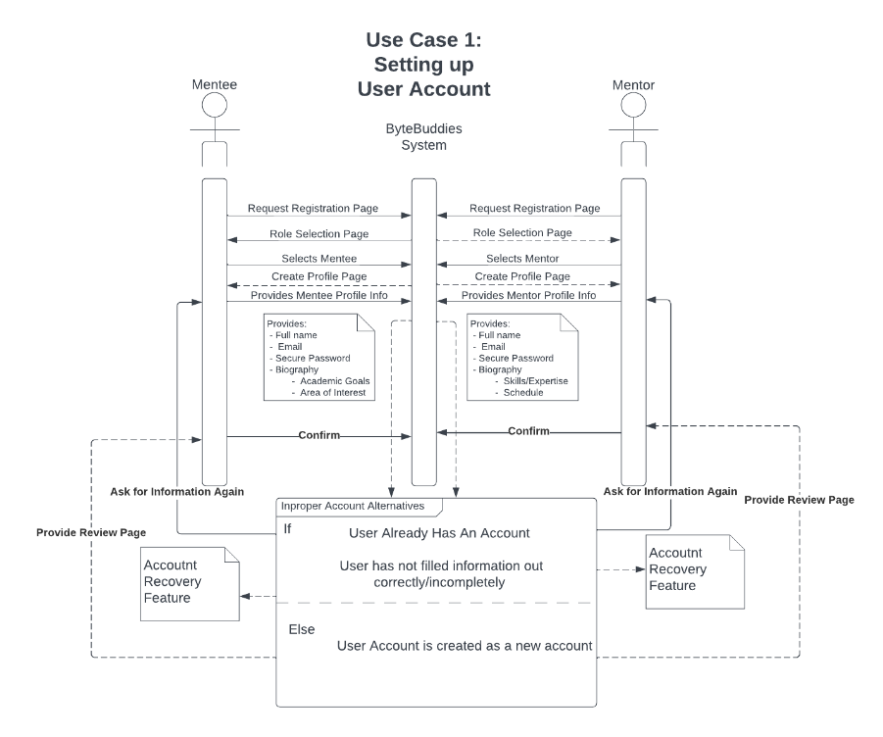
Use Cases (Login & Setup)
Objective | Steps | Features
User Account Setup & Mentor Selection | Users provide personal details, select roles, and agree to terms. Mentors input expertise, mentees list goals and interests. Validation, error handling, and account creation. | For Mentees: "Pick Mentors," "Apply for Mentors," "Find Resources." For Mentors: "Pick Mentees," "Set Meetings," etc.
Sequence Diagram for Login/Validation

Slide 8
Use Cases (Mentor Matching)
Objective | Steps | Features
Mentorship Interactions & Feedback | Mentor application and selection process. Mentees search and connect with mentors. Feedback provision and rating mentors. Mentor switch option and potential mentor dropout handling. | Facilitate efficient mentor-mentee interactions and accountability within ByteBuddies.

Slide 9
Limitations
The following are some limitations of the outlined solution:
Matching Accuracy Limitation
Dependence on User Engagement
Availability Challenges
Feedback Bias Concerns
Tool Effectiveness Limitation
System Reliability

Slide 10
Future Work
Full implementation of project
AI/ML algorithm for matchings
Profile assistance

Slide 11
Processes and Tools
Scrum
Retrospective
Sprint planning
Kanban
Less schedule intensive
Trello

Slide 12
Lessons Learned
2 different SWE processes
Pros vs Cons of each
Importance of requirements
Better at Git

Slide 13
Questions?

